Slide 1
Brazilian Ecommerce Dataset

Slide 2
Industry Review
Businesses have always tried to keep their customer base engaged and satisfied with the services provided by them. To remain relevant in the industry, they need to incorporate the latest technological advances into their services.
More than a decade back, it was the internet which was completely new and various industries tried to leverage the capabilities of this technology that effortlessly acted as a medium of communication between various businesses and their customers.
In this decade, industries have started to provide services that are catered towards each client’s individual needs. For such services, they are required to leverage the power of artificial intelligence.
Comprehending the reviews of customers is very crucial for a business to be successful. Analyzing the reviews helps to properly discern the customer different preferences, likes, dislikes, etc. These extracted insights can then be used to improve customer service and experience.

Slide 3
Business Problem:
Here we are working on a Brazilian E-commerce dataset where we would perform some exploratory data analysis (EDA) and derive meaningful insights from our analysis. This project has multiple datasets containing different fields such as orders, payments, geolocation, products, products_category, etc. but we would be mainly focusing on the customer orders dataset for our analysis.

Slide 4
Dataset and Domain:
olist_orders_dataset: This table is connected to 4 other tables. It is used to connect all the details related to an order.
olist_order_items_dataset: It contains the details of an item that had been purchased such as shipping date, price and so on.
olist_order_reviews_dataset: It contains details related to any reviews posted by the customer on a particular product that he had purchased.
olist_products_dataset: It contains related to a product such as the ID, category name and measurements.
olist_order_payments_dataset: The information contained in this table is related to the payment details associated with a particular order.
olist_customers_dataset: Details the customer base information of this firm.
olist_geolocation_dataset: It contains geographical information related to both the sellers and customers.
olist_sellers_dataset: This table contains the information related to all the sellers who have registered with this firm.

Slide 5
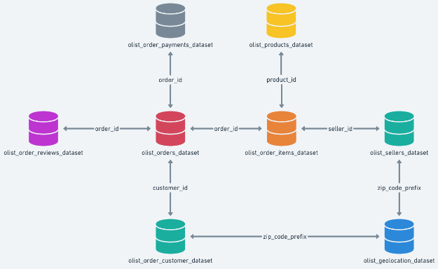

Slide 6
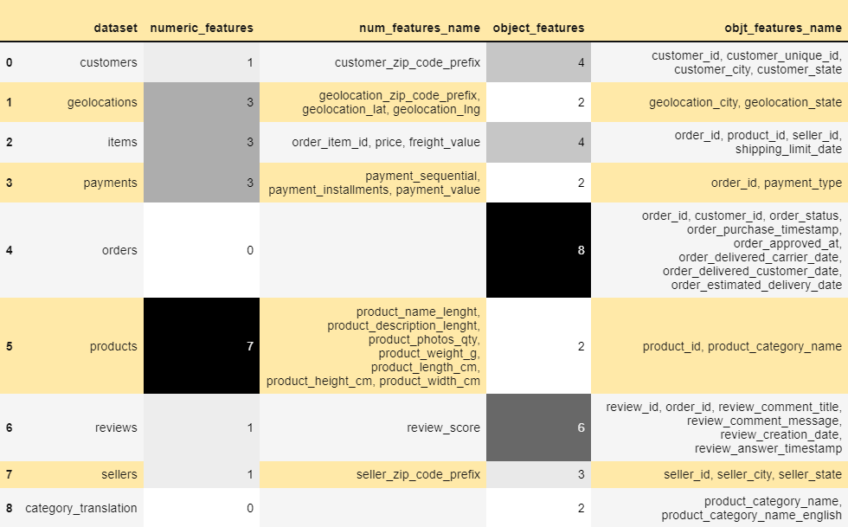
Variable categorization: categorical vs numerical

Slide 7
Observations:
Products dataset has maximum number of numeric features(i.e dtype: 'int16', 'int32', 'int64', 'float16', 'float32', 'float64')
Orders dataset has maximum number of features of object dtype.
We can also observe that all the timestamps are in object datatypes .So, we have to convert it into datetime type to do analysis on these features.

Slide 8
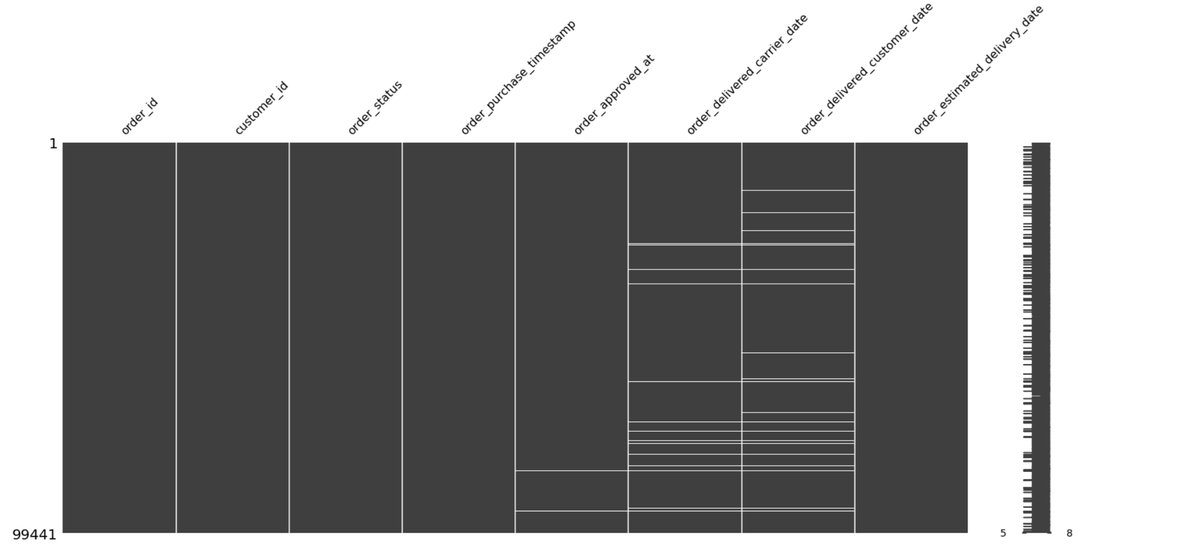
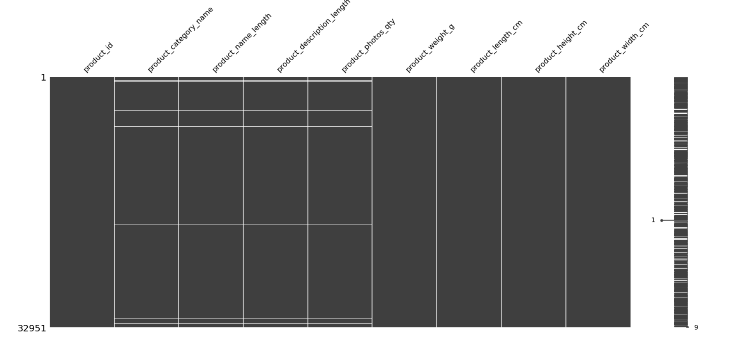
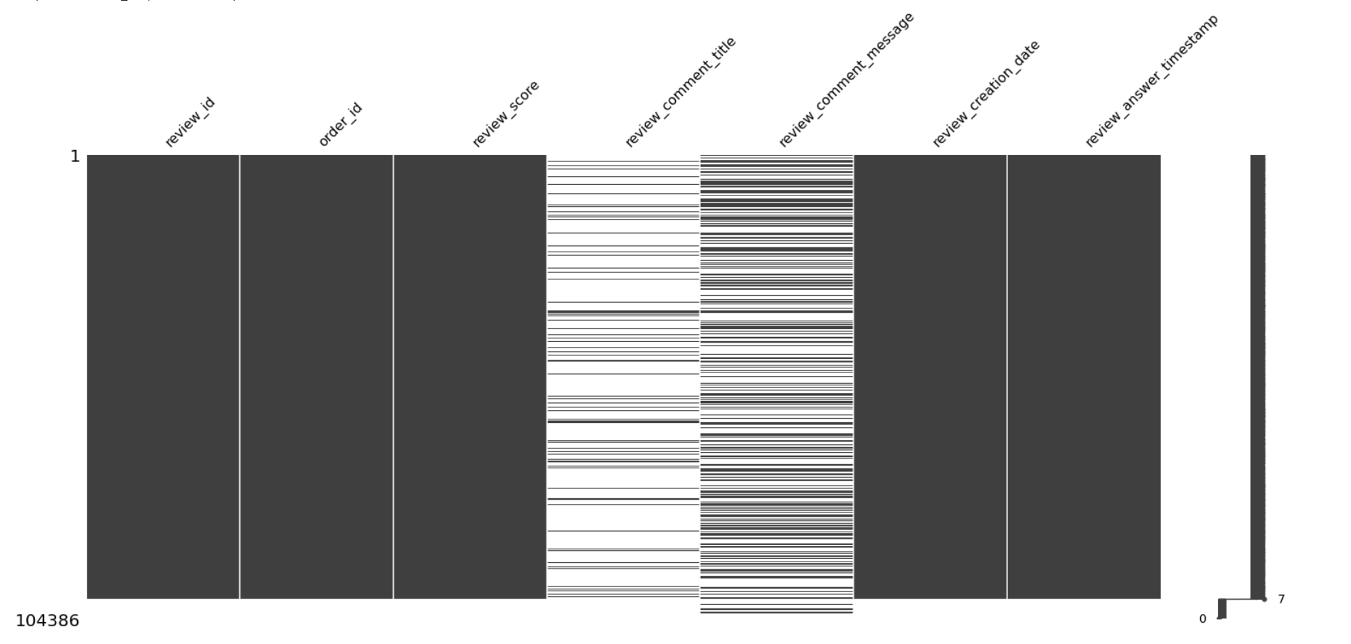
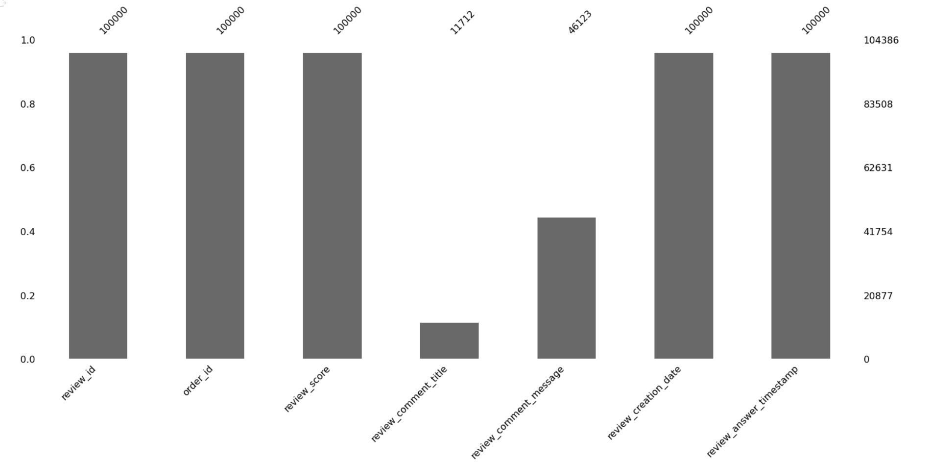
Missing values
olist_products_datas
olist_orders_dataset
olist_products_dataset
olist_orders_reviews_dataset

Slide 9
Project Justification:
Problem statement:
To understand the product placement as per the consumer needs that would help the retailers understand the consumer demands.
Project Outcome:
After the completion of the project, we will be predicting customer scores based on customer segmentation (recency, frequency, monetary value) for the company.

Slide 10
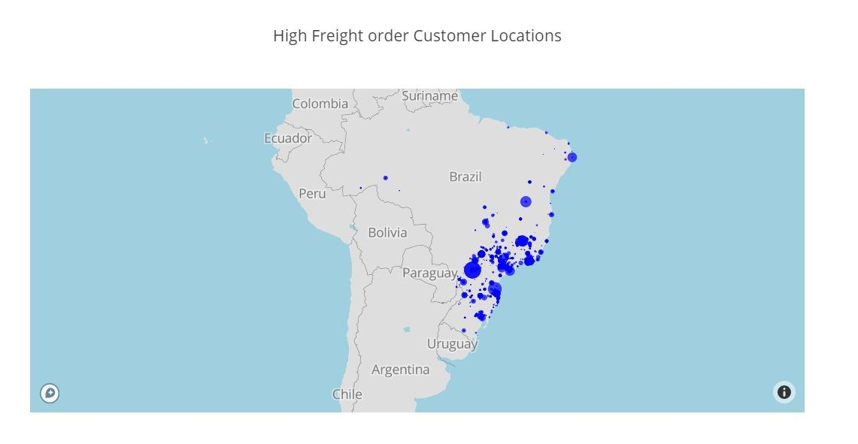
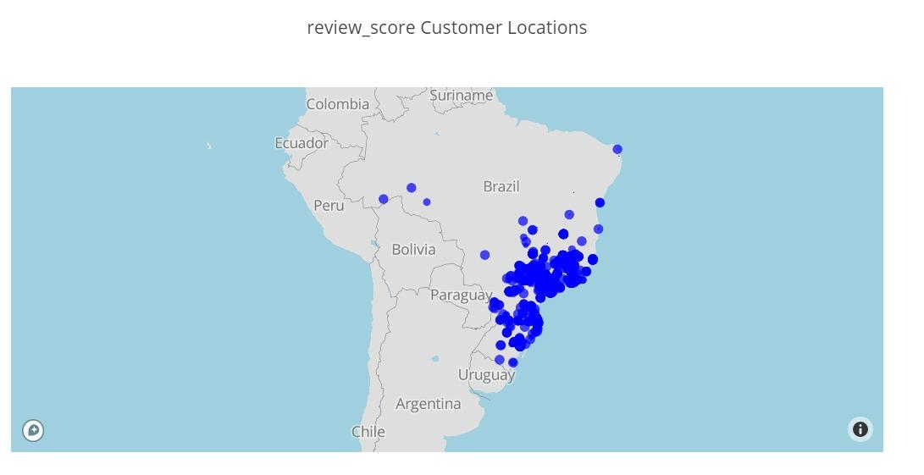
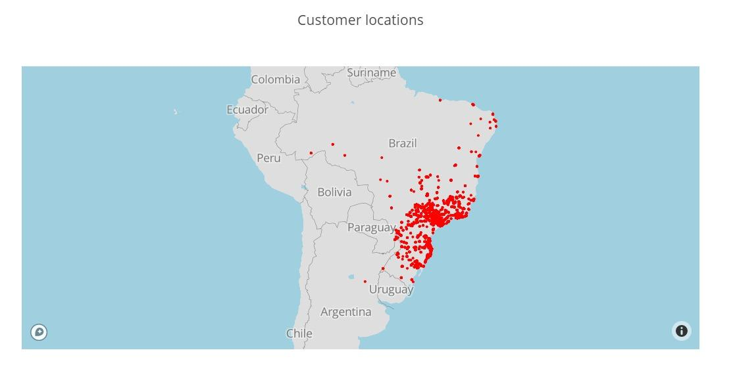
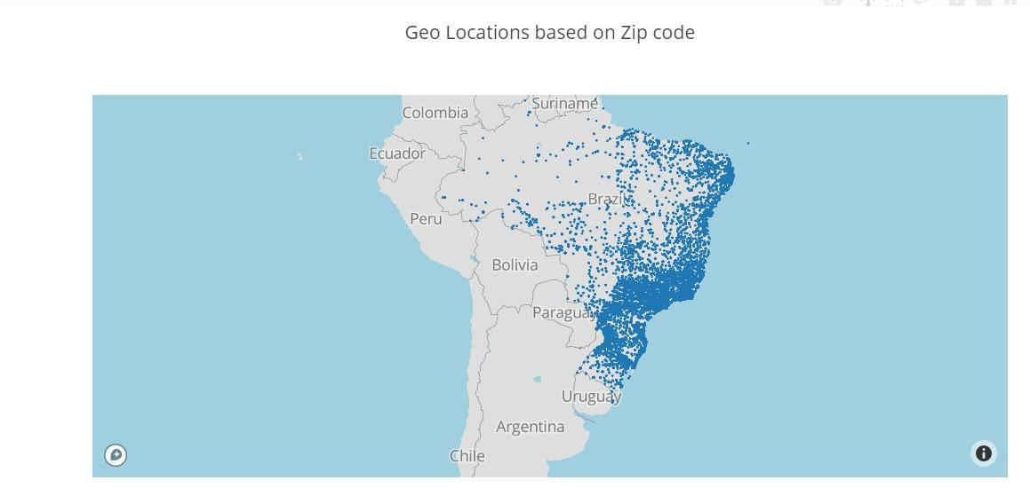
Data Exploration (EDA):
Univariate analysis:

Slide 11
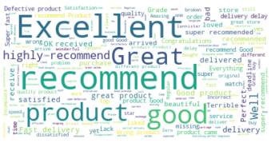
Word Cloud :
Initially the language of the review was translated from Portuguese to English. Then all the null values were dropped. Finally, word cloud was created which shows the words in order of their frequency. The word with highest frequency is shown bigger as compared to the word with the lowest frequency shown smaller.

Slide 12
RFM –Analysis
What is RFM?
Direct marketing is the control of customer acquisition and contact. It is important to quantify customer behaviour so that the short and long-term effect of segmentation formulae can be tested. RFM provides a simple framework for quantifying that customer behaviour. Once customers are assigned RFM behaviour scores, they can be grouped into segments and their subsequent profitability analysed. This profitability analysis forms the basis for future customer contact frequency decisions.

Slide 13
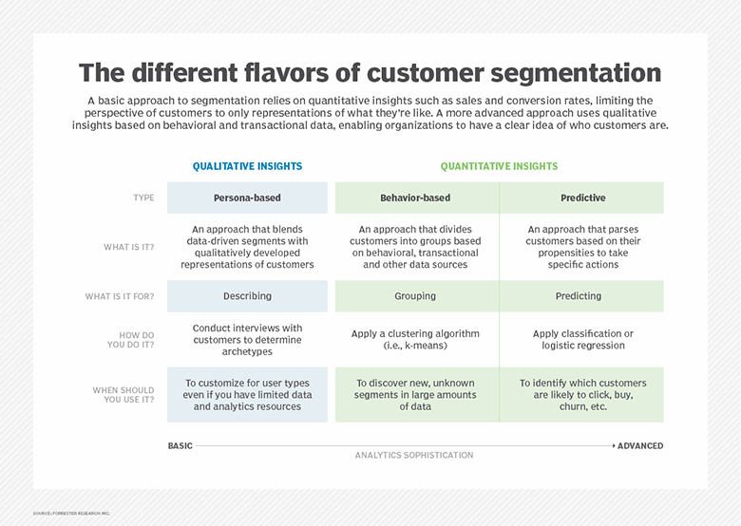

Slide 14
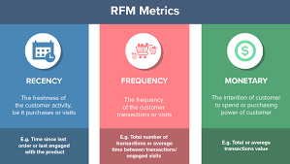
RFM analysis ranks each customer on the following factors:
Recency — number of days since the last purchase
Frequency — number of transactions made over a given period
Monetary — amount spent over a given period of time

Slide 15
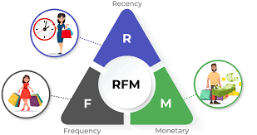
Process of RFM Analysis

Slide 16
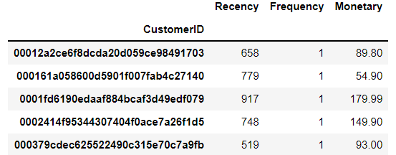
Process of RFM Analysis
Step1: Derive R, F & M
To calculate recency, we need to choose a date point from which we evaluate how many days ago was the customer's last purchase. The last date we have is 2018-09-03 so we will use it as reference.
Frequency helps us to know how many times a customer purchased from us. To do that we need to check how many invoices are registered by the same customer.
Monetary is the value of purchases, thus, we use the price column.
Sample calculations

Slide 17
Process of RFM Analysis
Step 2: Derive score of each customer based on each parameter based on rank within the parameter
For Recency, smaller the better, because of the customer, we are on top of his mind and for Frequency & Monetary larger values are better.
Step 3: Standardize score of each customer based on each parameter (0-100)
Standardize = current value/Max(Value) * 100
Step 4: Derive weighted score across each parameter for each customer
Consolidated Score = 0.15*R + 0.28*F + 0.57*M
We segregate score as three segments :
0 – 50 – Low valued customer
50 – 75 – Medium valued customer
76 – 100 – High valued customer

Slide 18
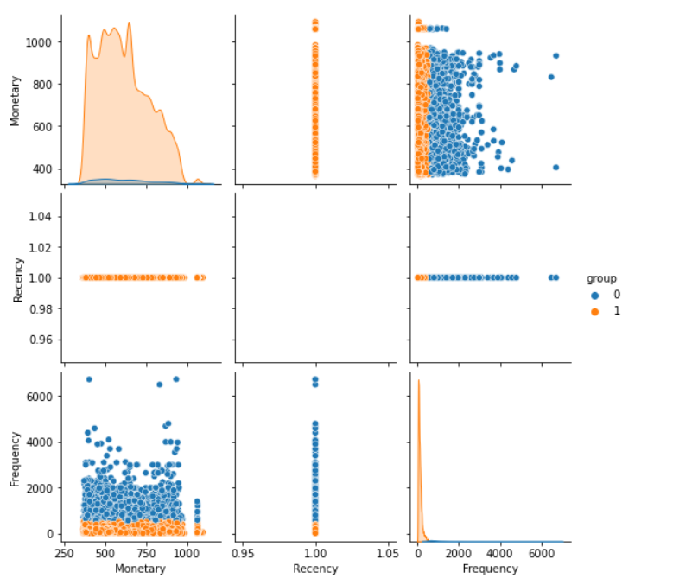
Process of RFM Analysis
Step 5: Customer segmentation using Unsupervised Learning (K-Means algorithm)
Applying K-means clustering on RFM variables, customers can be segmented into 2 groups.

Slide 19
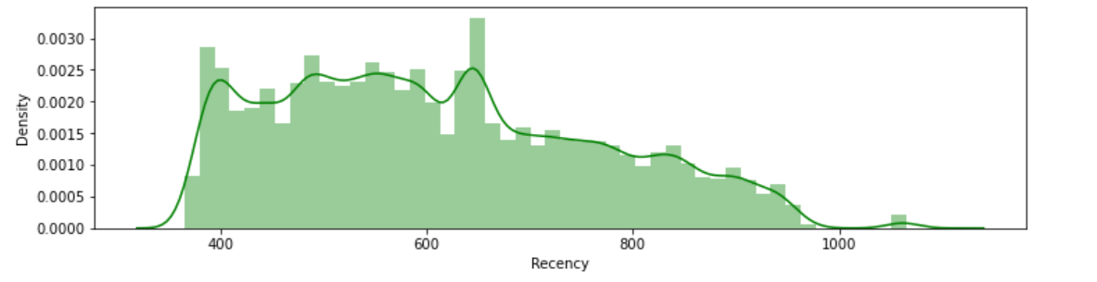
Observations:
There are three density plots of recency, frequency and monetary.
From the first plot of recency we can observe that most of the users stayed with olist for a long duration which is a positive thing but order frequency is less.

Slide 20
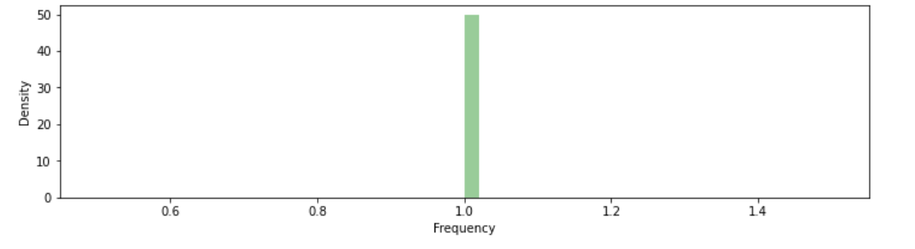
Observations:
B. From the second plot of frequency most number of transactions or orders is 1..

Slide 21
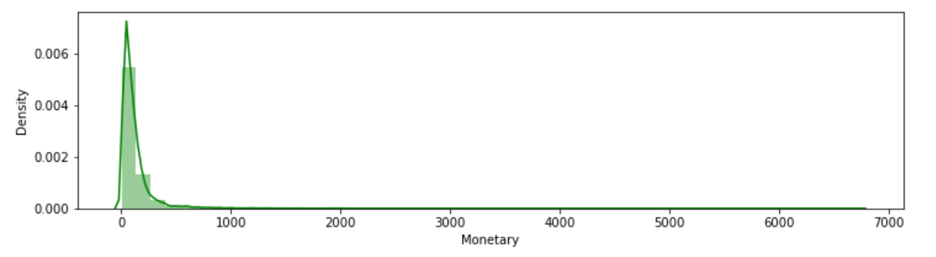
Observations:
C. From the third plot of monetary, the maximum amount spent over the given period seems to be less than 900 approximately.

Slide 22
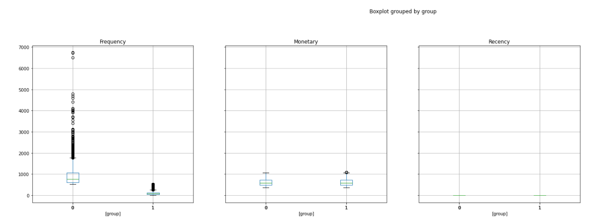
Observations:
D. From Customer segmentation using USL, it can be seen that customers with low frequency, low recency and high frequency scores are high value customers.

Slide 23
Scope -
Further scope of this project for us is to implement a predictive score for each and every customer and figure out the churn rate of customers.

Slide 24
REFERENCES
www.kaggle.com/olistbr/brazilian-ecommerce
www.nairaproject.com
www.theconversation.com
www.papers.ssrn.com

